Slide 1
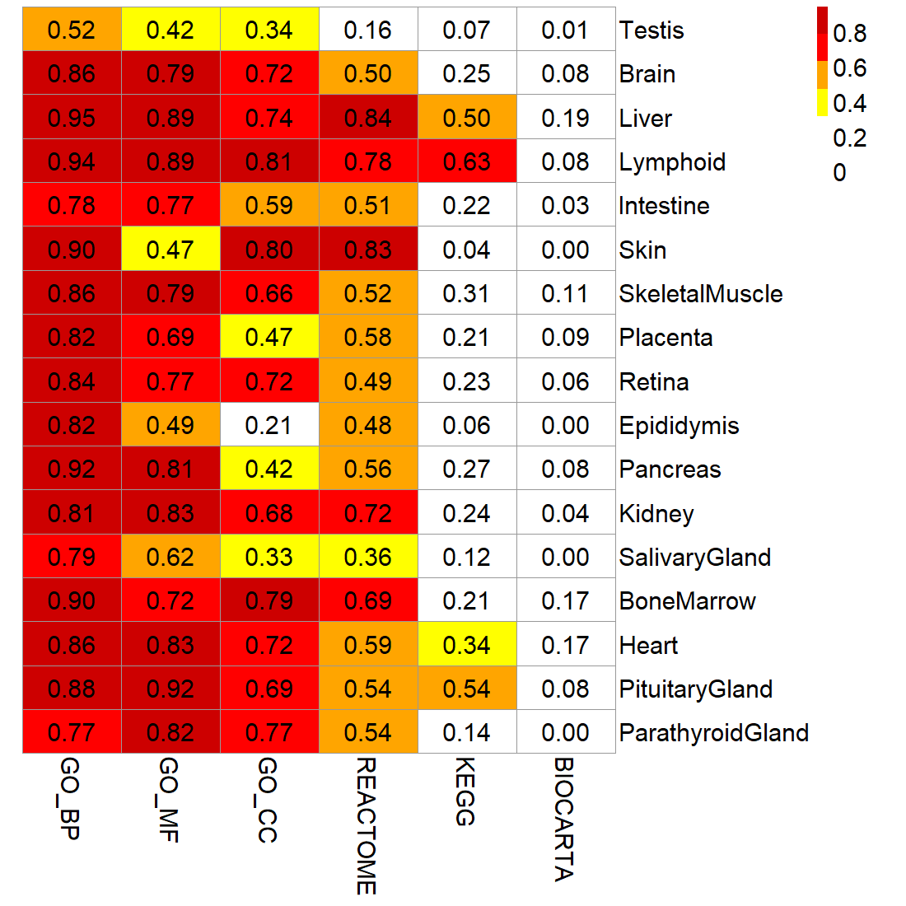
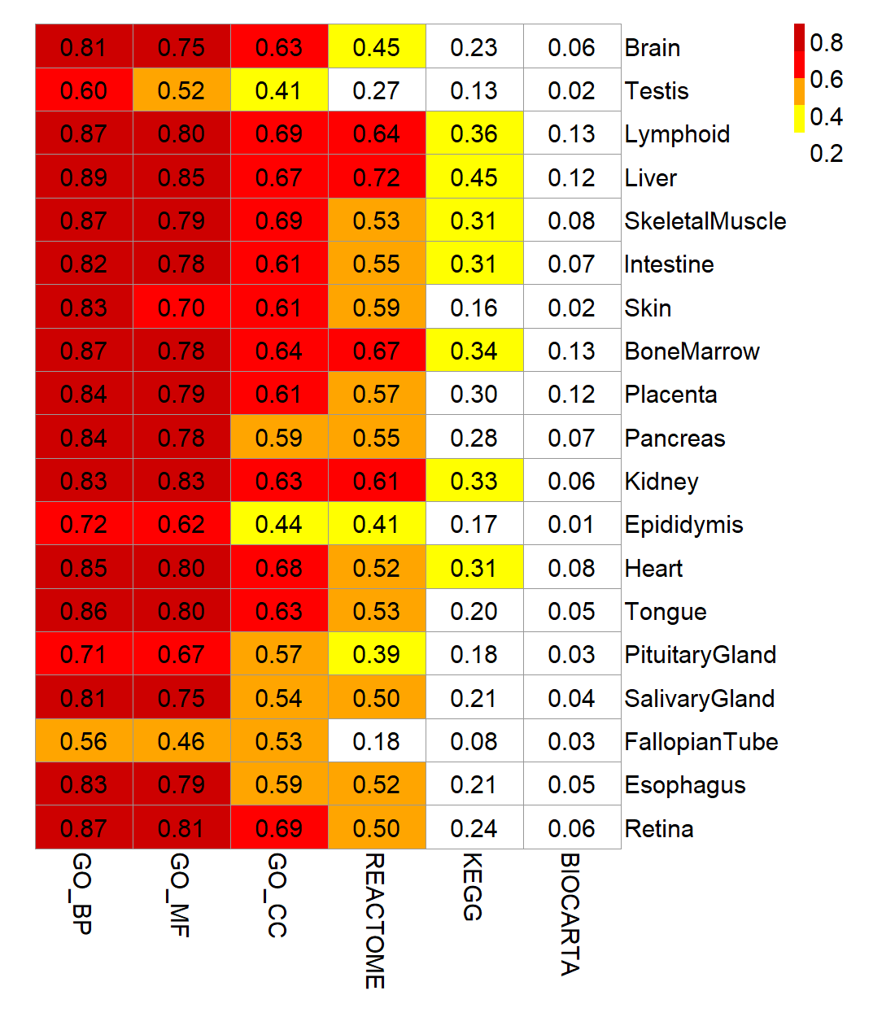
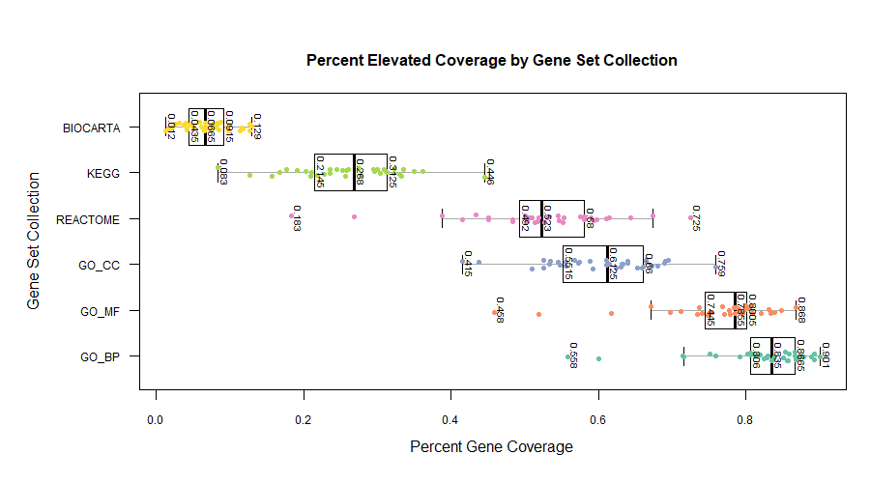
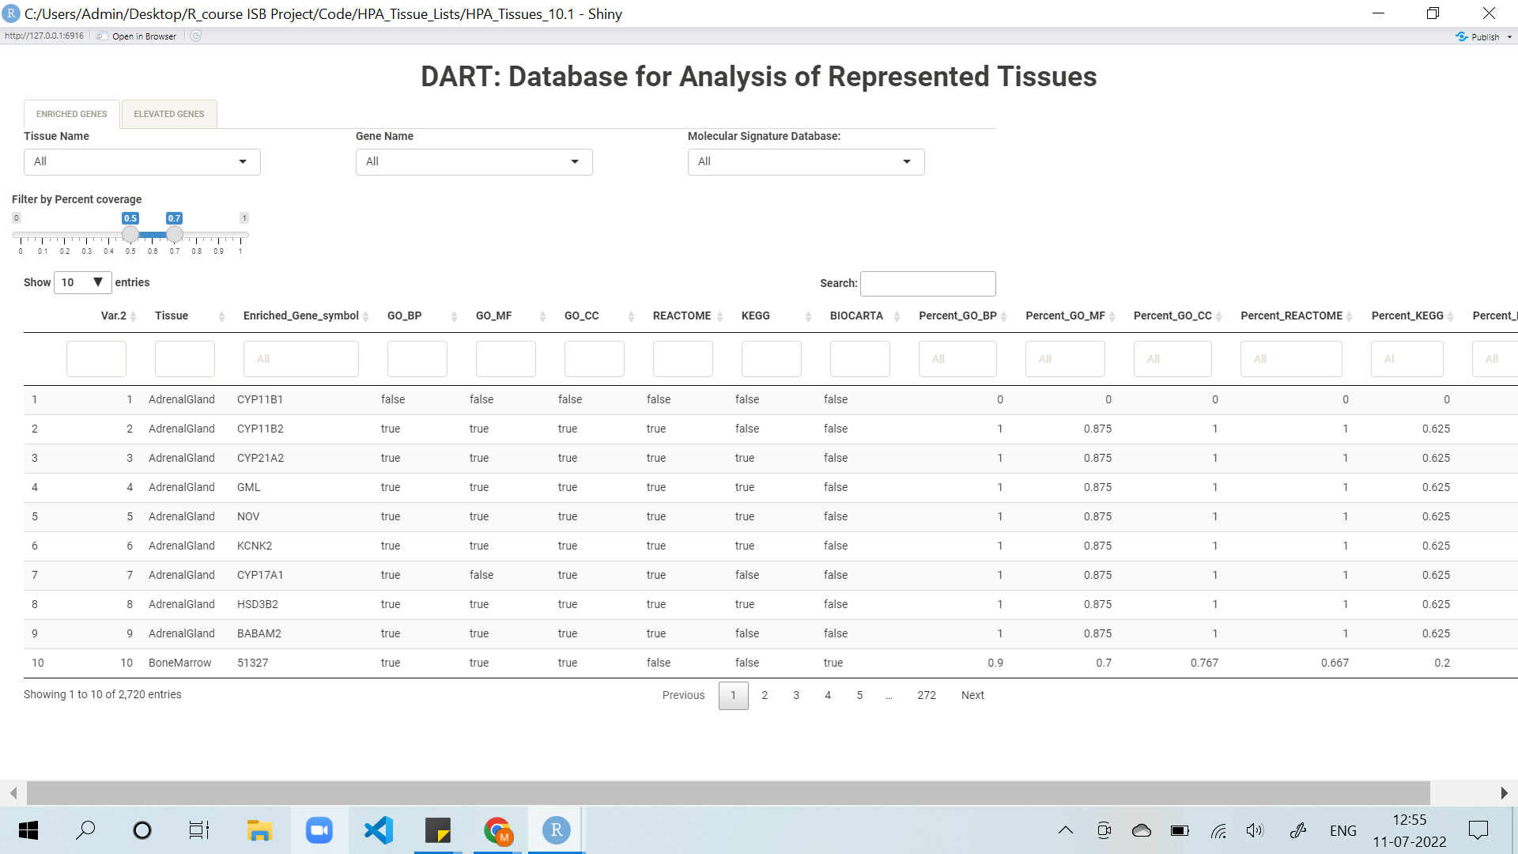
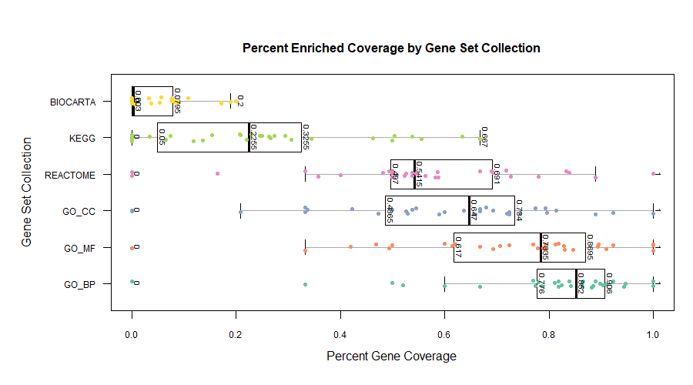
DART: A Database for Analysis of Represented Tissues
Authors: Gina Hyunh¹ , Mehlam Saifudeen^{1,2}, Alison Paquette³, Priyanka Baloni¹ , Noa Rappaport¹
¹Institute for Systems Biology, Seattle, WA ; ²Case Western Reserve University, Cleveland, OH;
³Seattle Children’s Research Institute, Seattle, WA
Tissue Bias in Gene Set Collections May Bias Enrichment Analysis
Tissue elevated/enriched genes have higher mRNA expression in one/several tissues as compared to other tissues.
Pathway Enrichment analysis is a method used to determine which pathways are over represented in a list of genes (e.g. differentially expressed genes), in order to gain mechanistic insight into experimental results.
Gene sets used for enrichment analysis (e.g. Gene Ontology, KEGG, etc.) can be biased towards particular tissues, which in turn can bias enrichment analysis results in cases where the tissue of interest is not well represented.
Goals:
Calculate tissue biases in gene set collections often used for enrichment analyses.
Generate a resource to facilitate pre-selection of gene set collection for enrichment analysis.
Tissue Coverage is different among popular gene set collections
Methods
PubMed query was used to select the top 6 most used gene set collections (GO (BC, CC, MF), KEGG, Reactome, BIOCARTA).
Genes from the gene set collections were annotated “enriched” or “elevated” using the Human Protein Atlas (HPA)¹.
Coverage of tissue elevated and enriched genes was observed across tissues for each gene sets database.
To demonstrate potential use cases for DART both theoretical and sample case studies of impact of tissue coverage on enrichment analysis results were analyzed.
Enriched:
Elevated:
A
A Database for Analysis of Represented Tissues (DART)
FIGURE 1: Coverage of tissues in order of best to worst coverage for (a) elevated tissues with >250 genes (b) enriched tissues with >20 genes
FIGURE 2:
Screenshot of the R Shiny database application showing tissue coverage of enriched and elevated genes for popular gene set collections.
Planned capabilities
Search: tissue name, Gene name, Molecular Signature Database (MSigDB) name
Filters: by fractional coverage of each gene from a scale of 0 to 1.
File inputs: user inputs of the gene list to optimize gene set collection selection
Download search results: user can download the search results on their device in various formats
Different tabs / buttons for querying: Options for user to choose amongst a list of search and querying the results they want to generate
FIGURE 3:
The distribution of the percent gene coverage of each tissue in order of lowest to highest coverage for (A) 36 elevated tissues and (B) 32 enriched tissues.
Search by Tissue Name
Search by Gene Name
Search by Gene Set Collection name
Filter based on tissue coverage
B
Funding
Generous contribution from Carole Ellison
References
¹https://www.protein atlas.org/

Slide 2
OUTLINE
Introduction:
Define tissue specific genes - higher mRNA expression in one gene as compared to another gene……
Pathway enrichment analysis: method used to determine which pathways are over represented in a list of differentially expressed genes.
This can be a powerful tool to associate disease phenotype to a group of genes.
Although gene sets selected can be biased which in turn can affect enrichment analysis results where tissue is not well represented.
Objectives:
Our goal is to generate a searchable, quarriable database called DART to represent the coverage of tissue specific genes in popular gene set collection databases often used for enrichment analyses.
User friendly querying and searching options would include searching by…..
Additional filters for search results would include …….
Methods:
PubMed search was used to find the usage of the top 6 gene set collections.
Genes from the gene set collections matched with tissues from the HPA and the matched sets were added to the database
Tissue specific genes in the HPA are defined as either enriched or elevated (define these 2 if needed)
Coverage of tissue elevated and enriched genes was observed across tissues in gene set databases. (show some examples in figure 1)
Results:
Figure 1: shows gene set collection coverage of genes varies amongst tissues. Some have consistently low coverage and some have consistently higher average across databases for both enriched and elevated. Eg. testis, pituitary, placenta, etc. for lower and lymphoid and liver for higher.
Figure 2: boxplot that shows percent gene coverage for each tissue in each of the 6 MSig Dbs
Demo of database / conclusion
Figure 3: shows database with different tabs for the various searching requirements (name them).
Slide bar allows us to narrow search by percent coverage within the database
Option to download the search results as a file on user device
Also another search feature where user can input their list of genes and find out which MSigDb would be the best for enrichment analysis for their result

